Slide 1
Build a simple application with Data Access using Spring & Spring JDBC, Spring ORM

Slide 2
Objectives
Build Desktop application with Data access
Create a new Maven project in Eclipse IDE
Add the necessary dependencies for Spring MVC and data access
Create the Model - Define the entity classes that represent domain objects
Define the data access object (DAO) interfaces and their implementations for interacting with the database.
Create the Controller
Set Up the Views
Create the views using JSP, Thymeleaf, or another templating engine
Implement the Business Logic
Testing
Run the Application

Slide 3
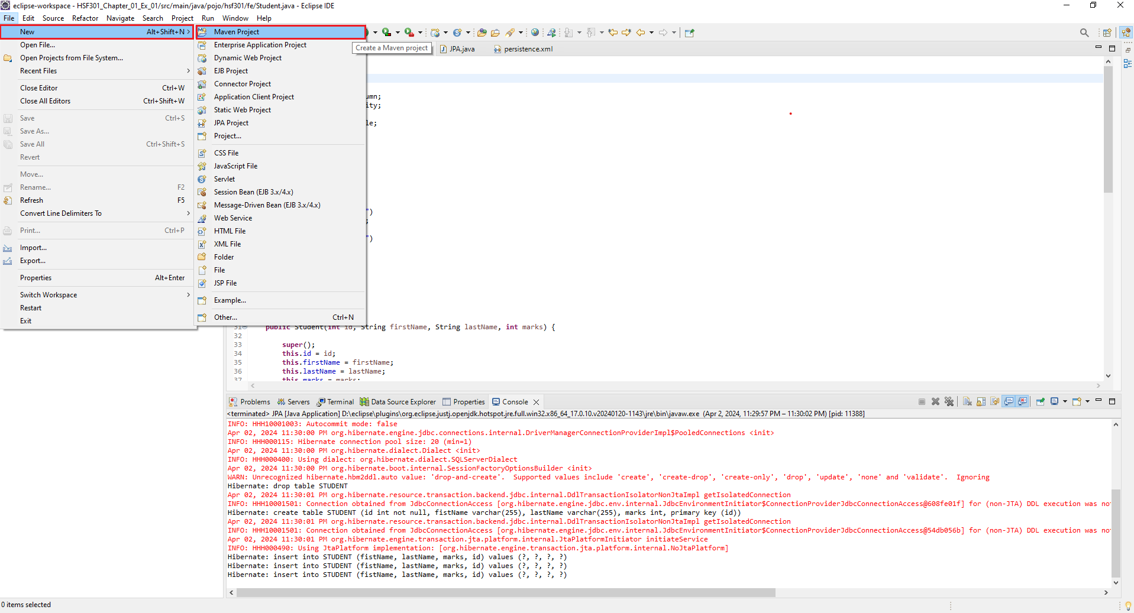
1. Open Eclipse, File | New | Maven Project

Slide 4
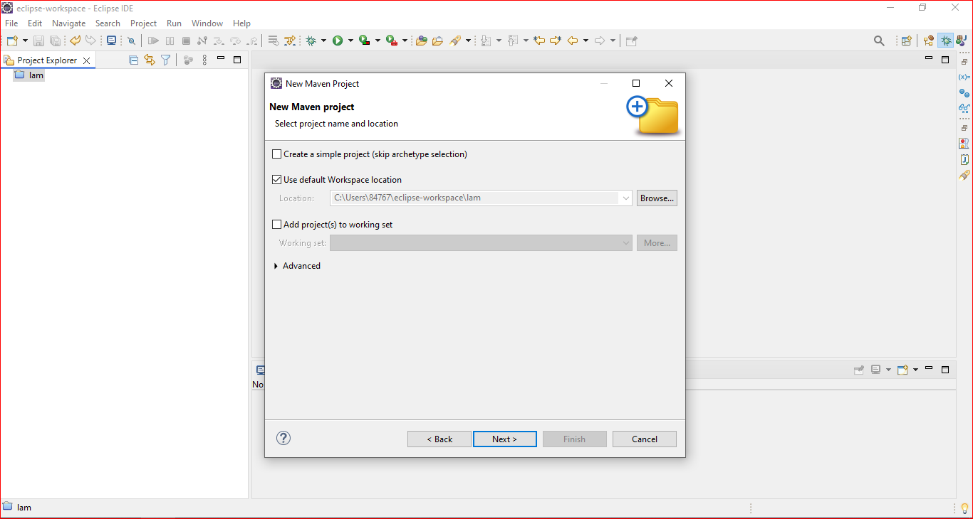
2. Check Create a simple project -> Browse Project -> Next

Slide 5
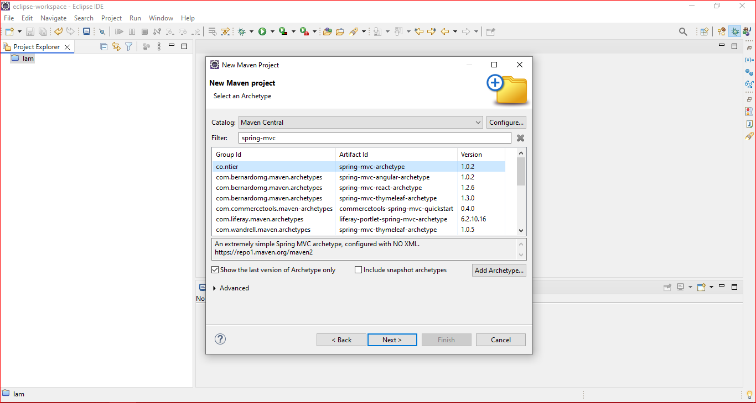
3. Fill the information Project -> Click Finish

Slide 6
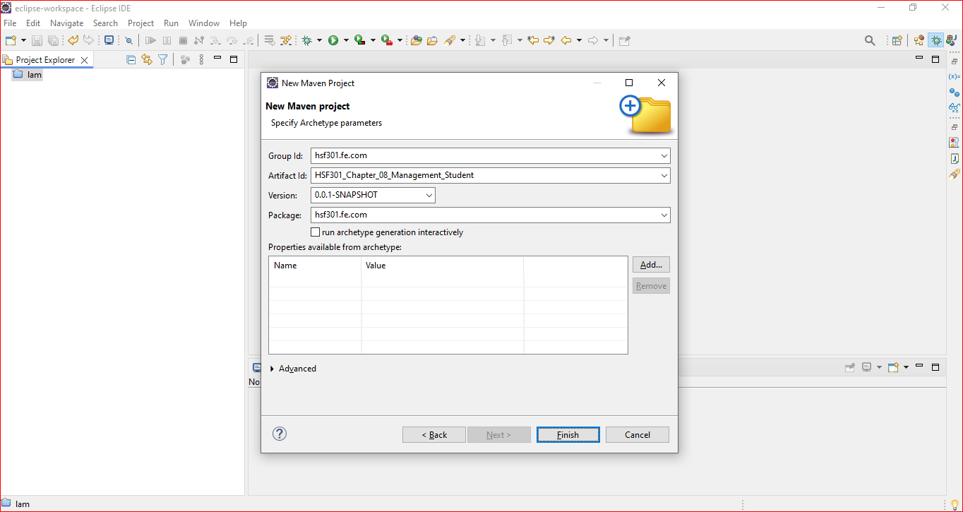
4. Fill the information Project -> Click Finish

Slide 7
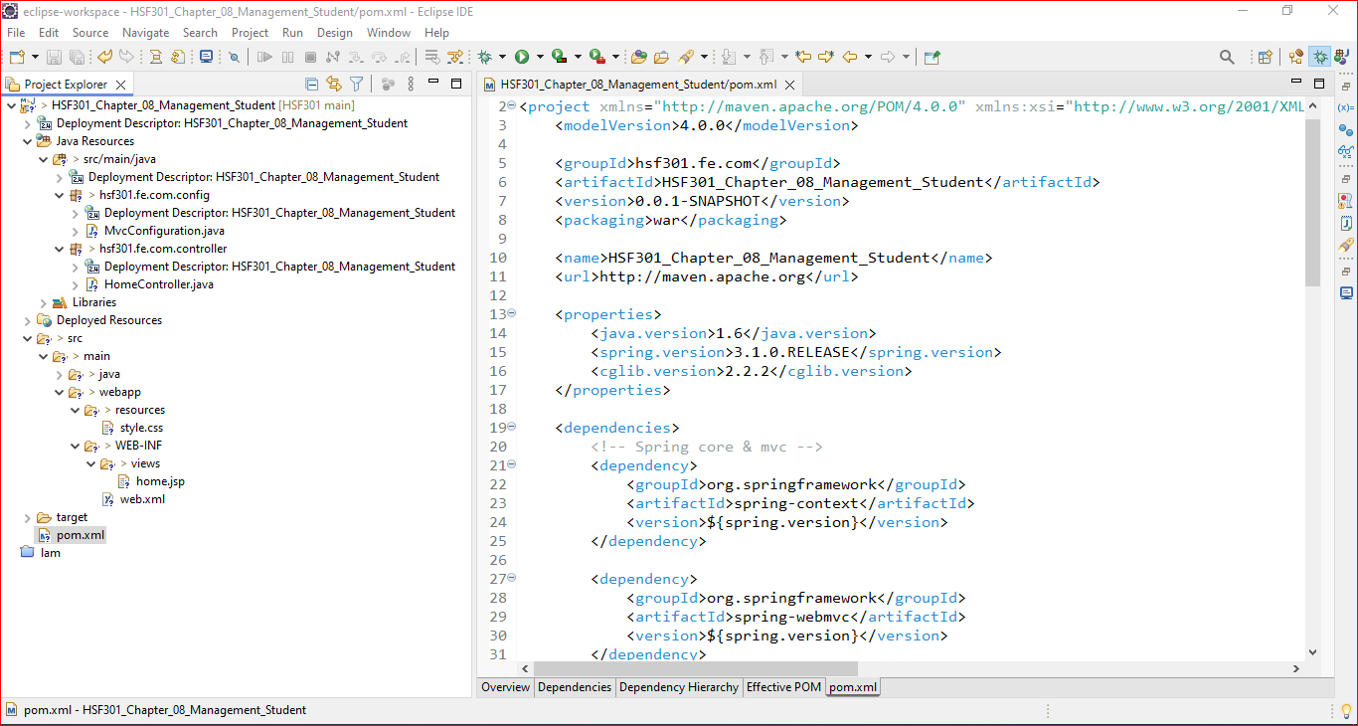
5. Structure of Maven Project

Slide 8
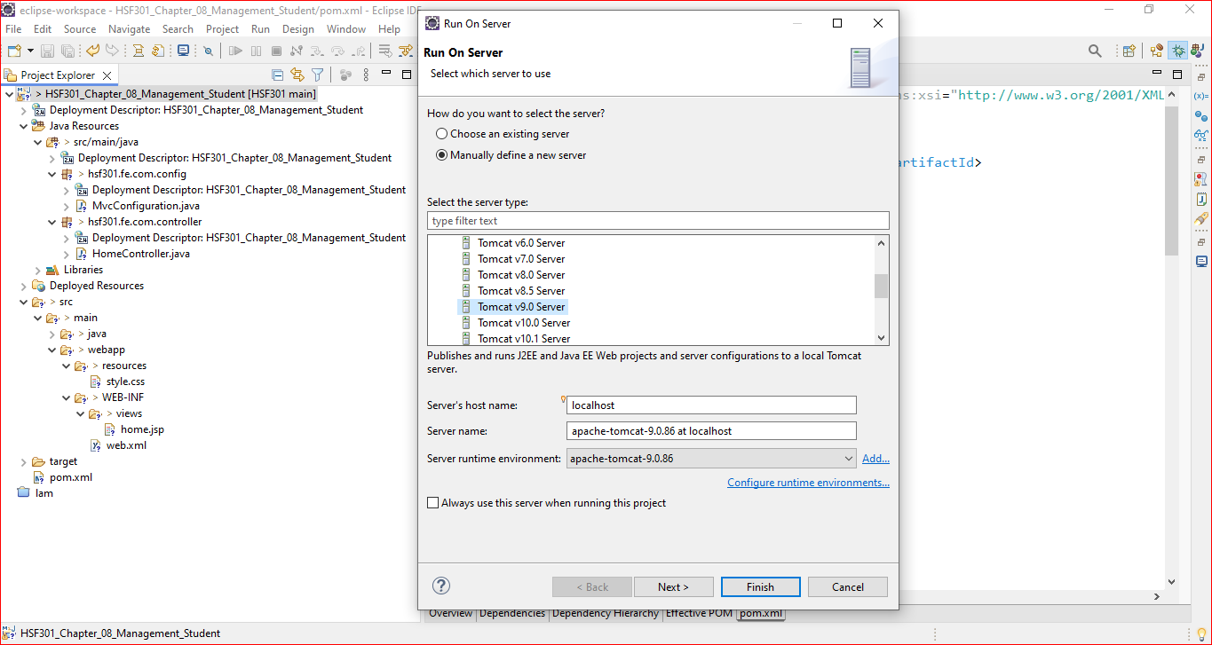
6. Right Click -> Run On Server

Slide 9
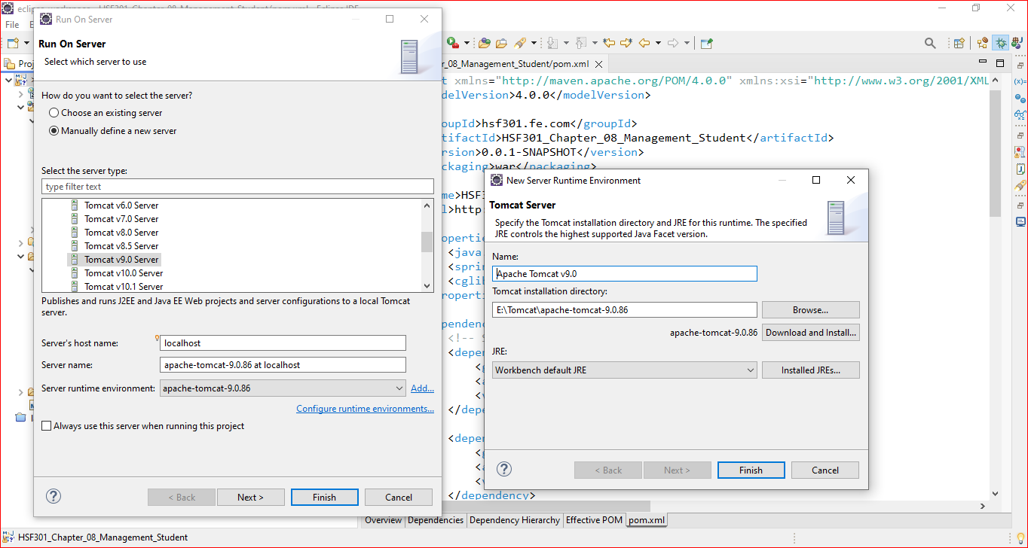
7. Browse the Server Location

Slide 10
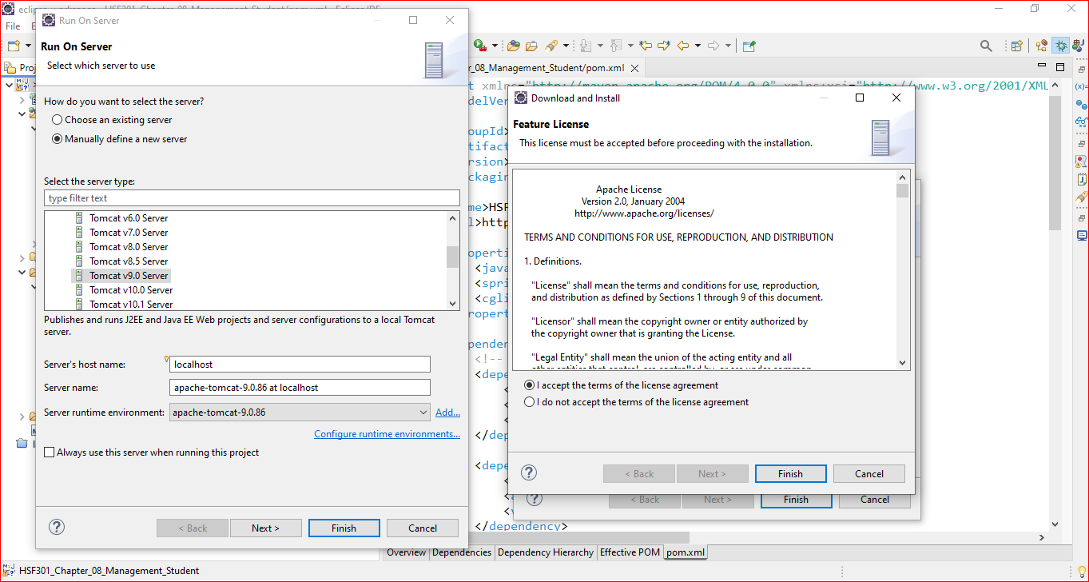
8. Click Download and Install

Slide 11
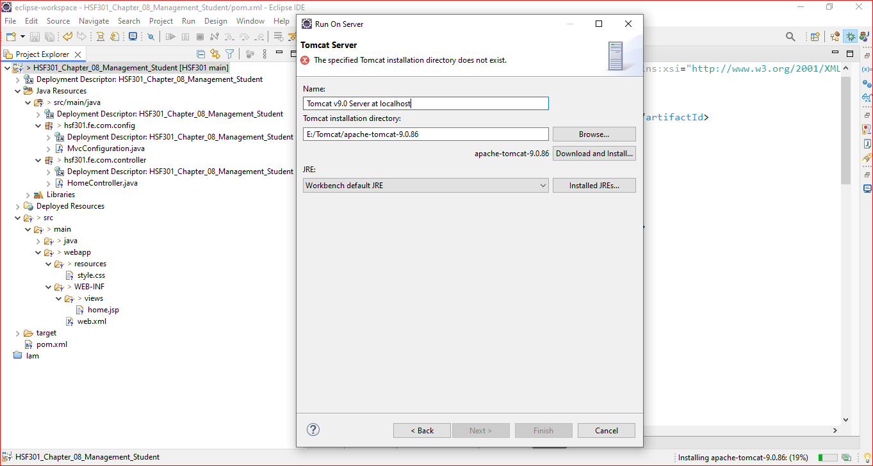
9. Next -> Finish

Slide 12
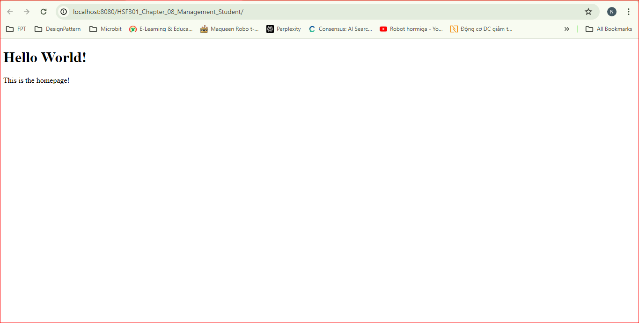
10. Result

Slide 13
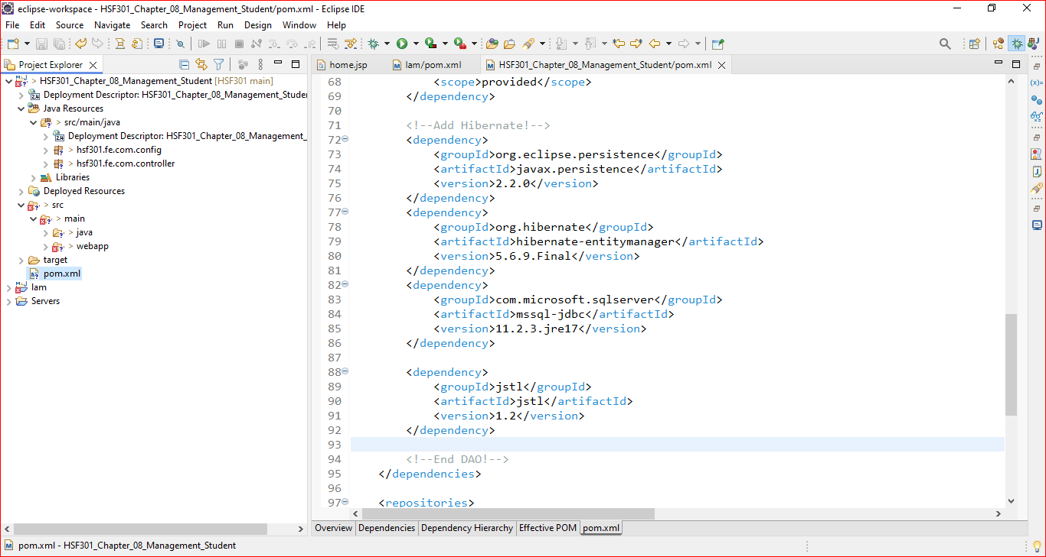
11. Edit pom.xml

Slide 14
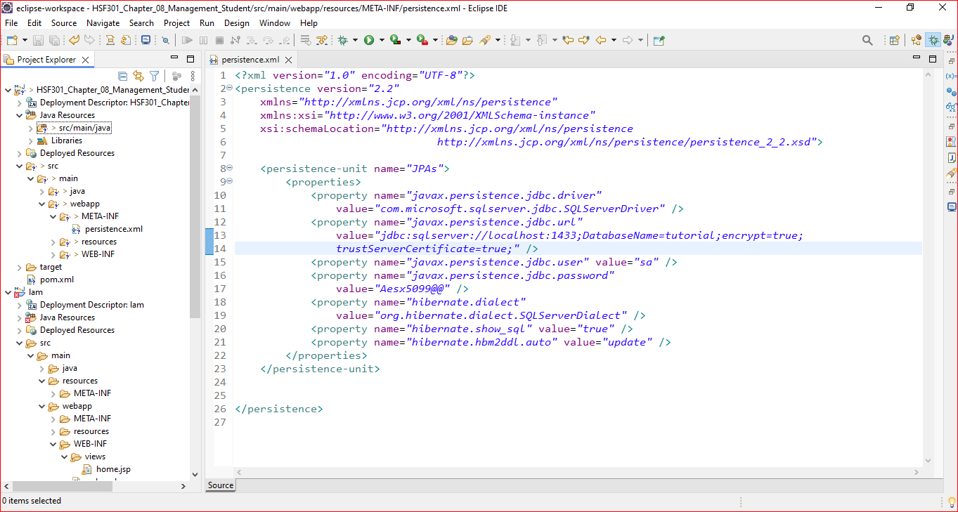
12. Create META-INF and persistence.xml File

Slide 15
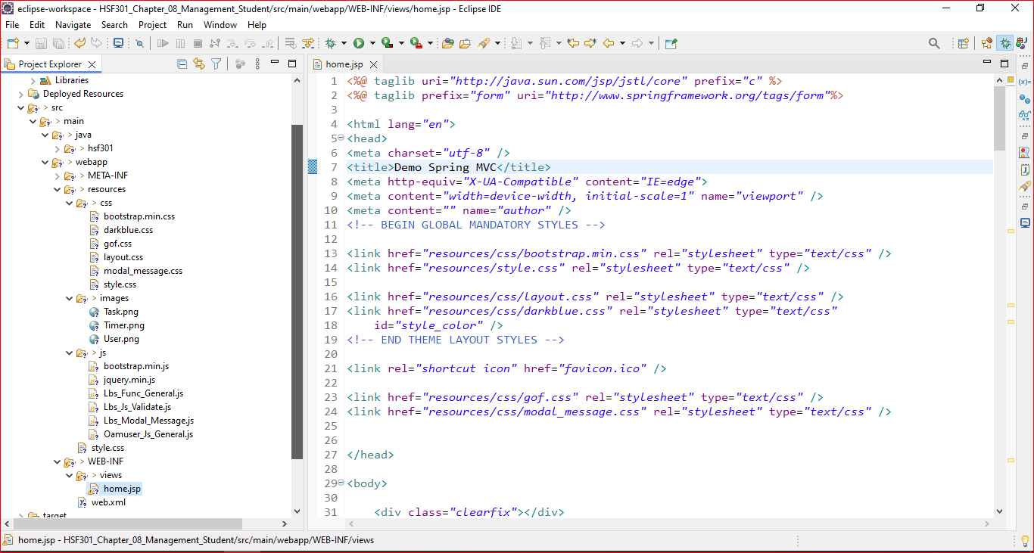
13. Copy material into project

Slide 16
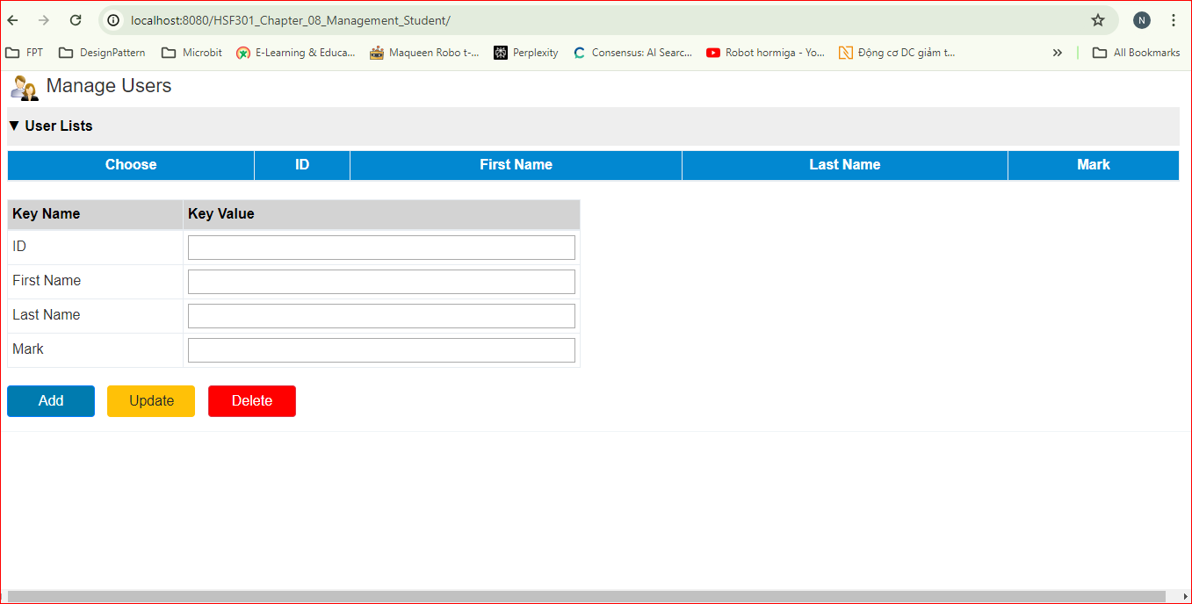
14. Result

Slide 17
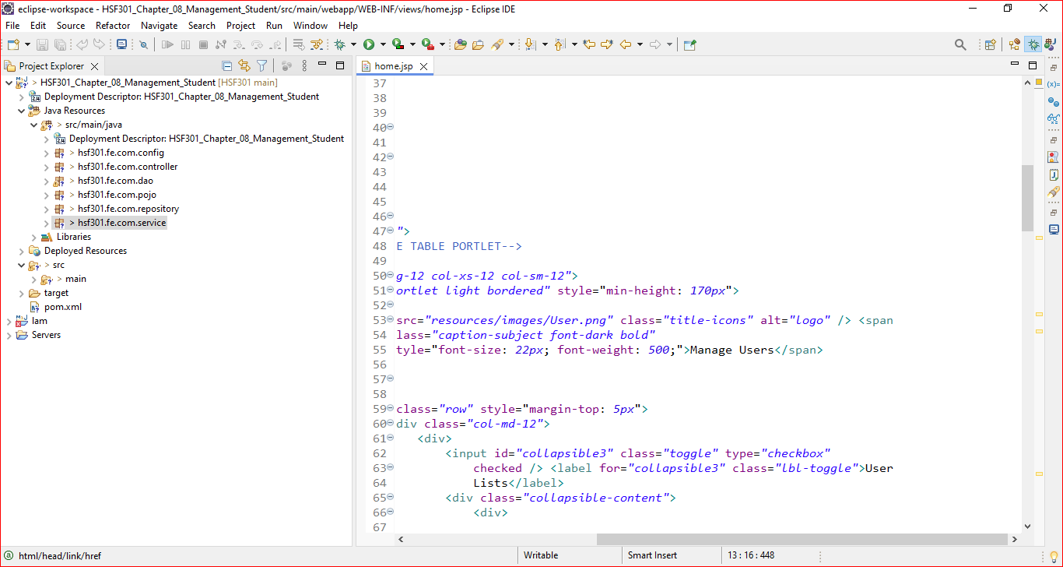
15. Build the Architecture

Slide 18
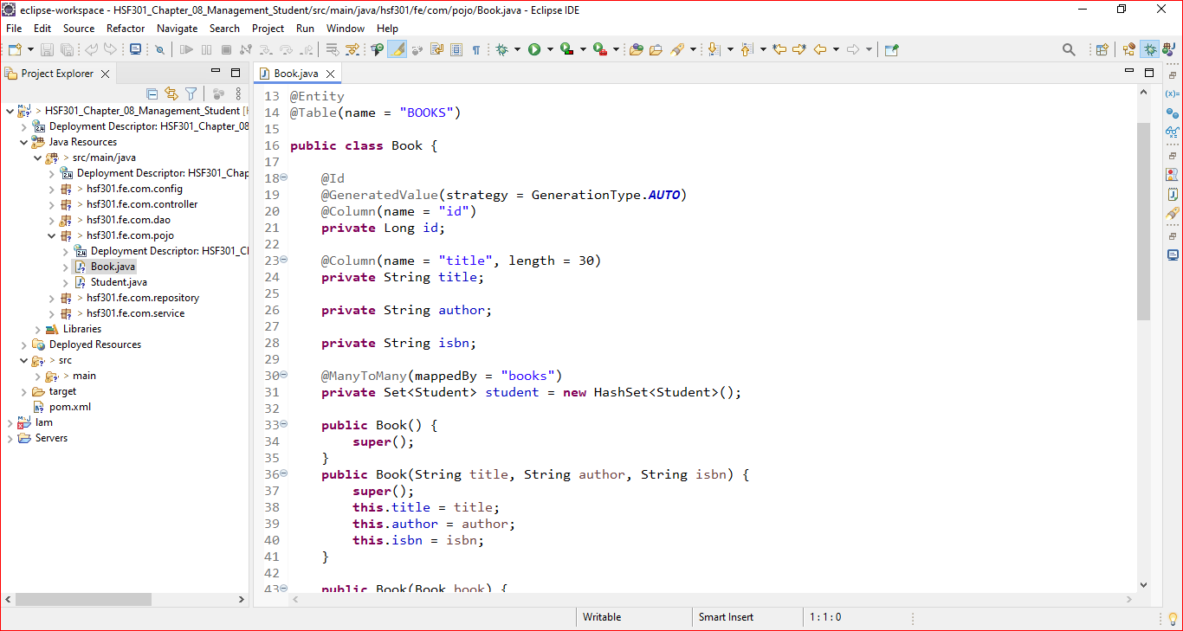
16. Create Books in Pojo

Slide 19
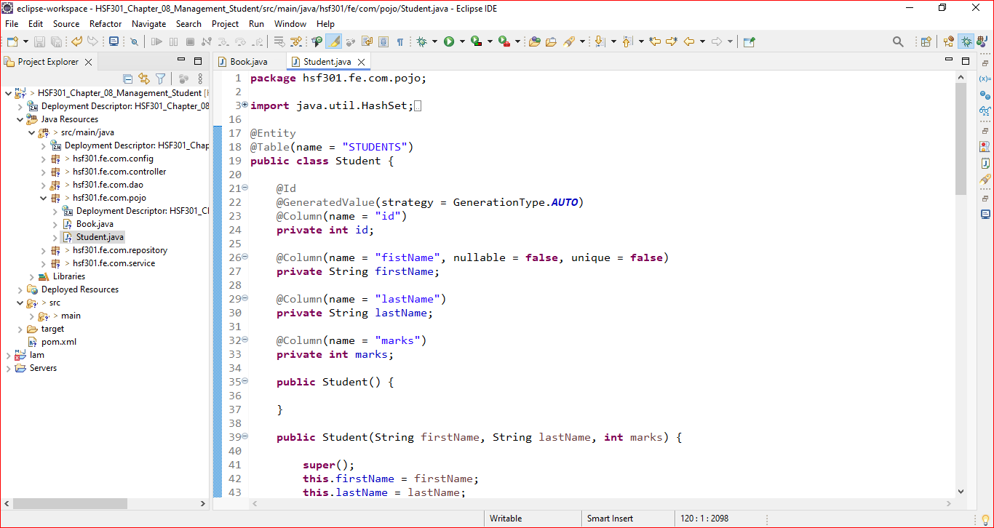
17. Create Students in Pojo

Slide 20
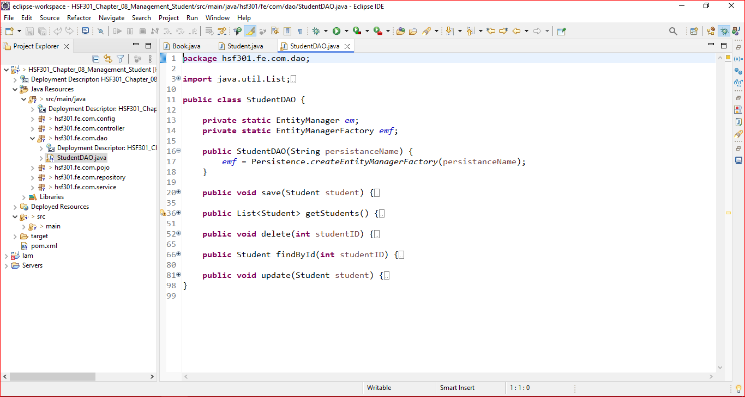
18. Create StudentDAO

Slide 21
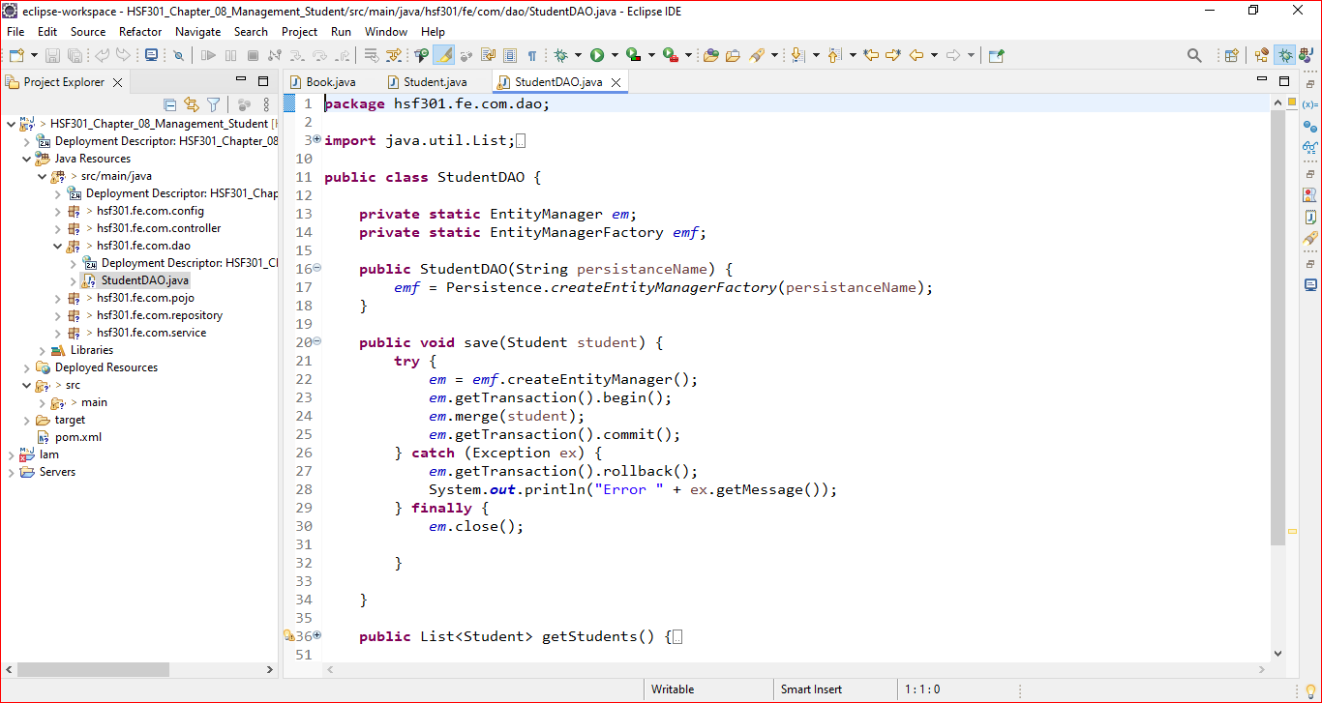
19. Save Student in StudentDAO

Slide 22
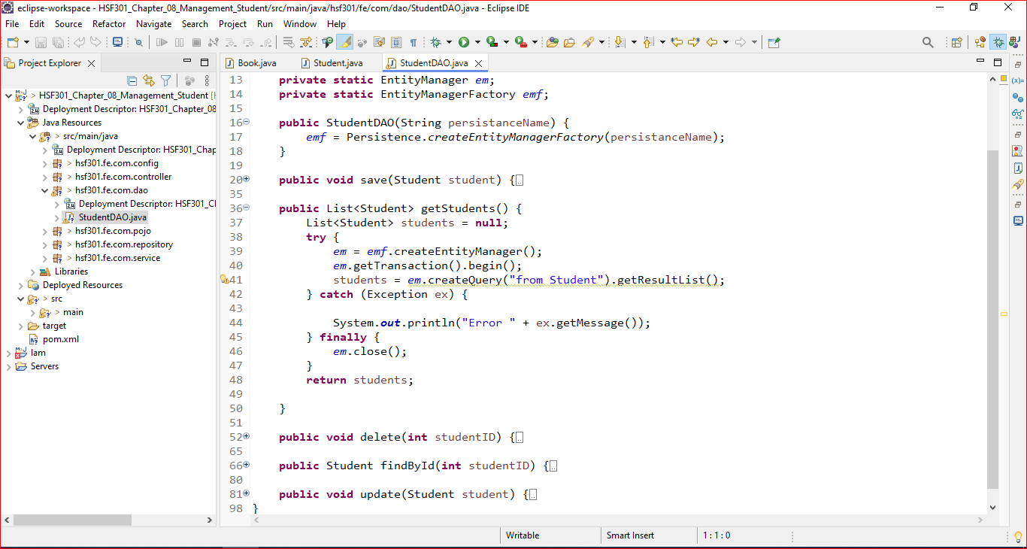
20. Get All Student in StudentDAO

Slide 23
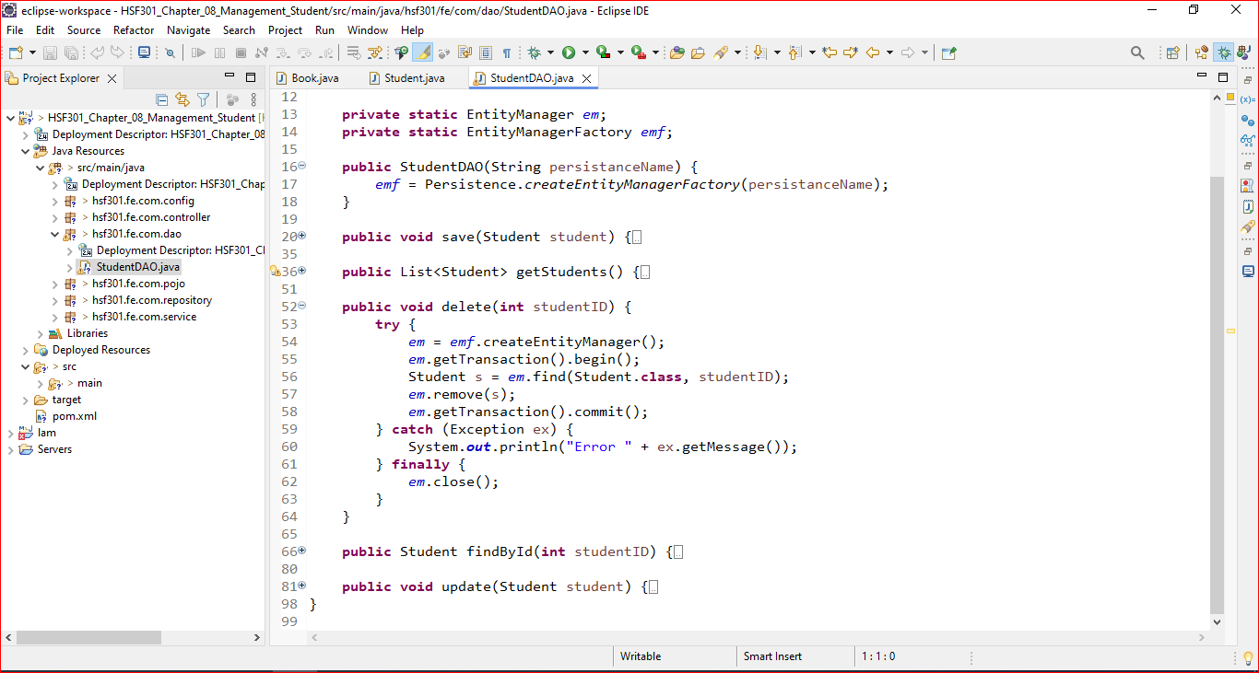
21. Delete Student in StudentDAO

Slide 24
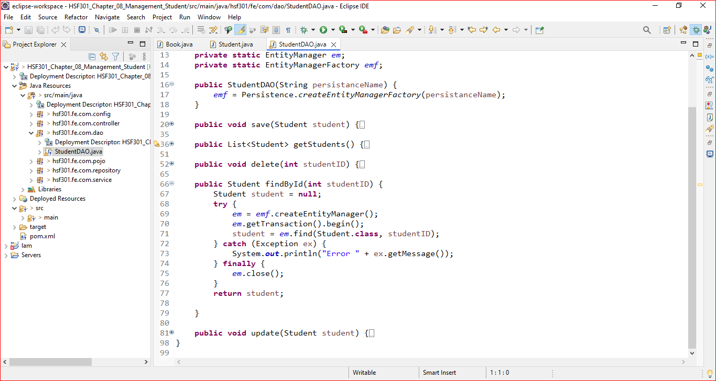
22. Find A Student in StudentDAO

Slide 25
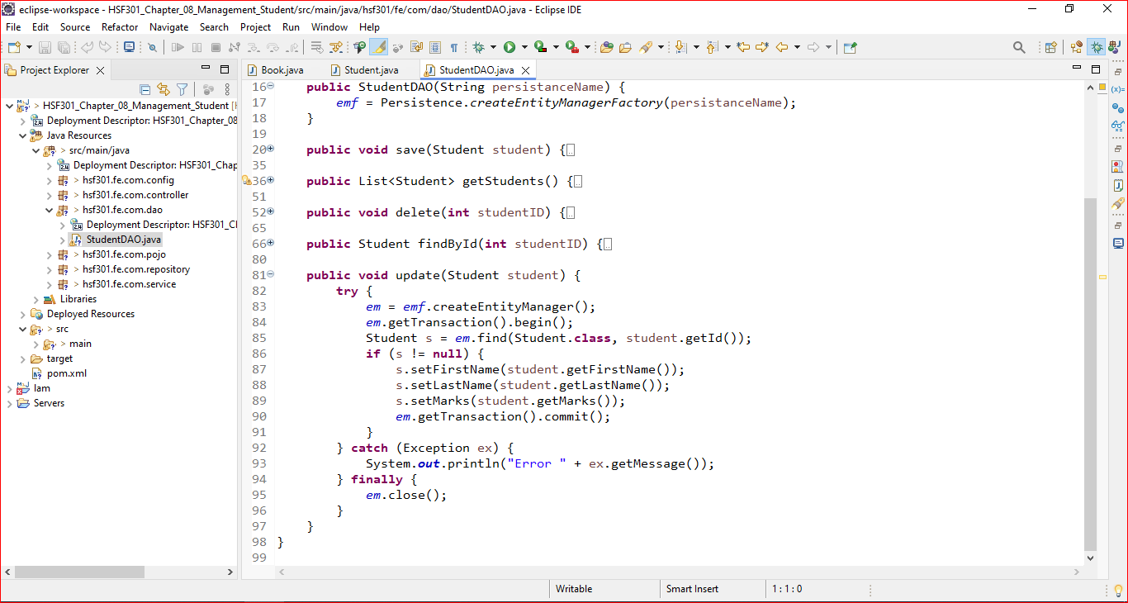
23. Update a Student in StudentDAO

Slide 26
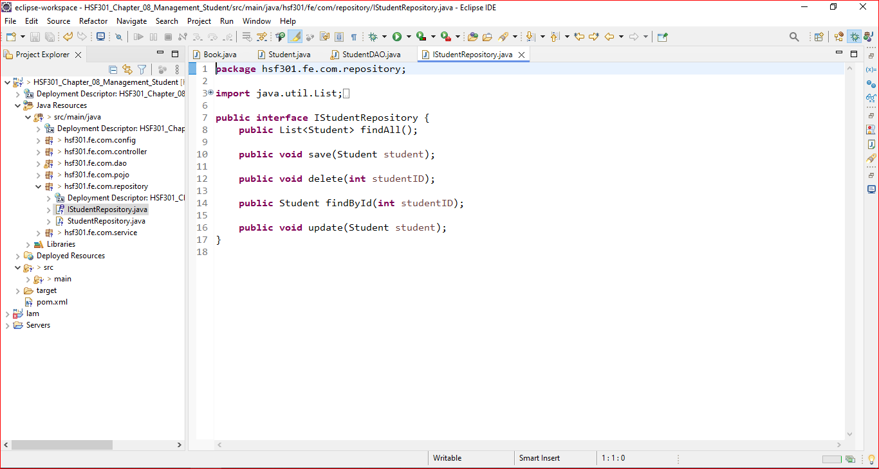
24. Create IStudentRepository

Slide 27
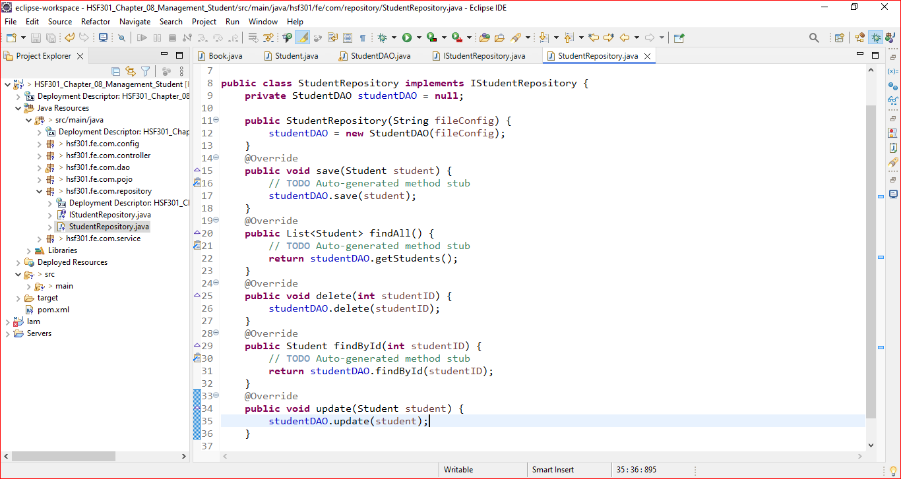
25. Create StudentRepository

Slide 28
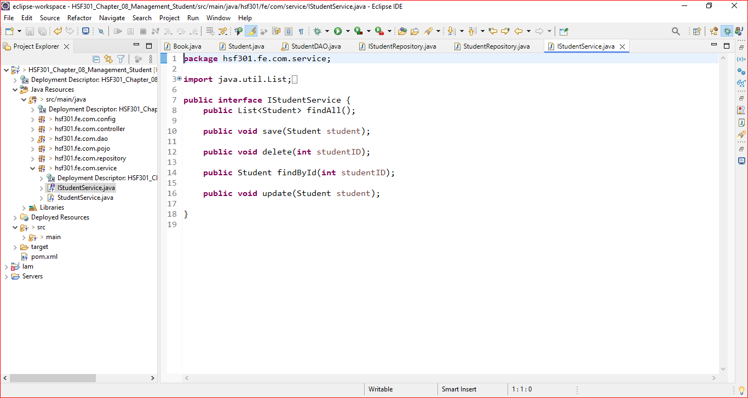
26. Create IStudentService

Slide 29
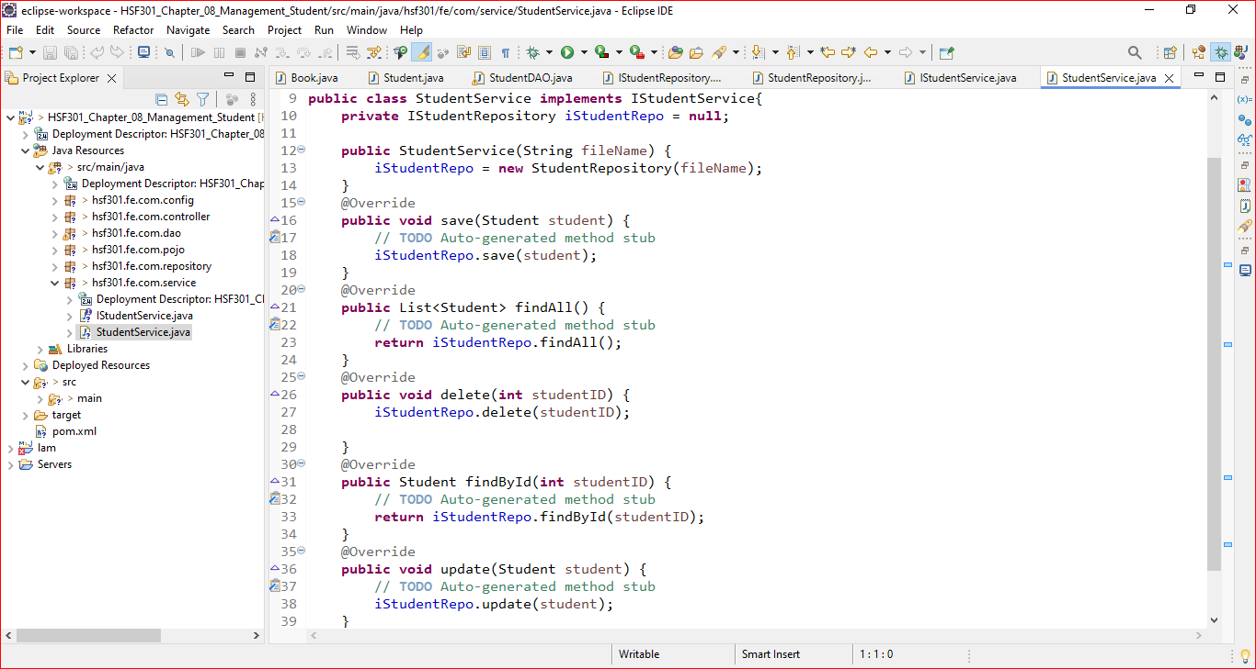
27. Create StudentService

Slide 30
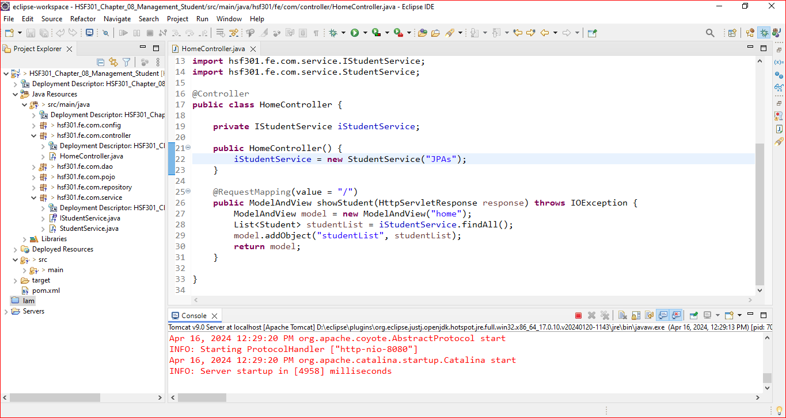
28. Edit HomeController.java

Slide 31
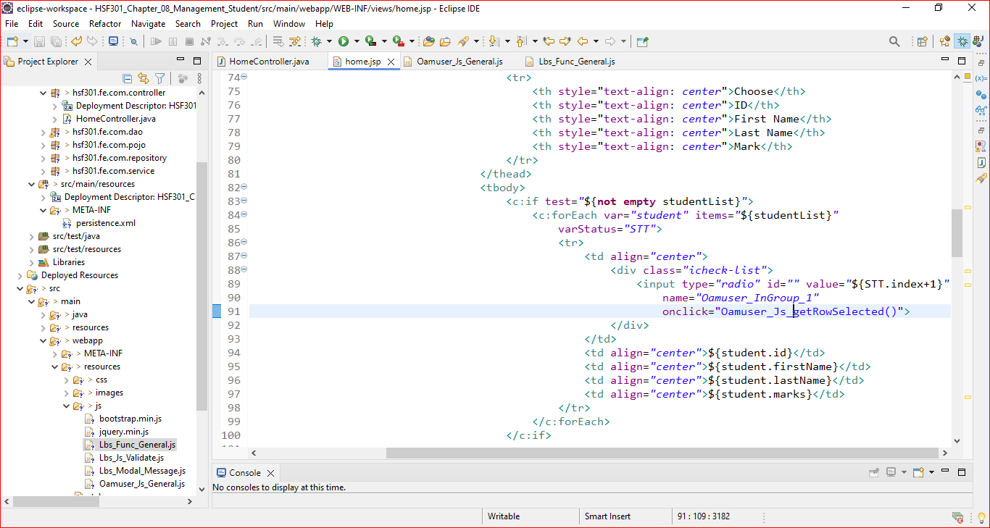
28. Edit Home.jsp

Slide 32
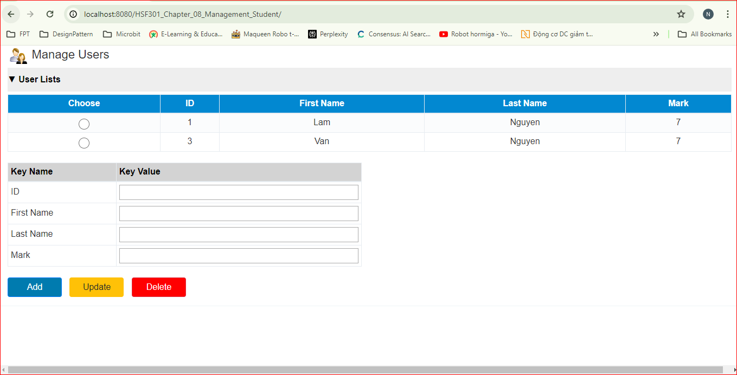
19. Result

Slide 33
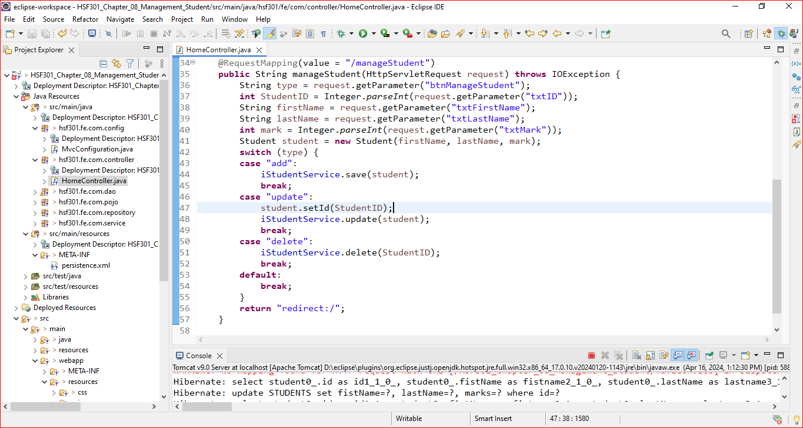
20. Edit the HomeController.java

Slide 34
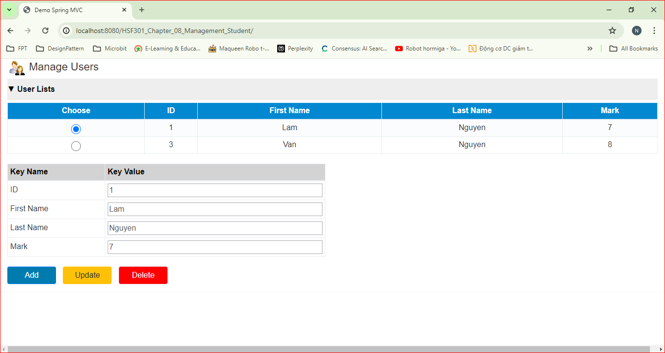
21. Result

Slide 35
Summary
The concepts are introduced:
Create a new Maven project in Eclipse IDE
Add the necessary dependencies for Spring MVC and data access
Create the Model - Define the entity classes that represent domain objects
Define the data access object (DAO) interfaces and their implementations for interacting with the database.
Create the Controller
Set Up the Views
Create the views using JSP, Thymeleaf, or another templating engine
Implement the Business Logic
Testing
Run the Application

